Slide 1
Nucleic Acid Extraction
Bio 208
Week 2

Slide 2
DNA
Nucleotide chains that carry the genetic instructions used in the growth, development, functioning & reproduction of most living organisms.
DNA stores biological information.
Each nucleotide is composed of one of four nitrogen containing nucleobases, deoxyribose, and a phosphate group
cytosine (C), guanine (G), adenine (A), and thymine (T)

Slide 3
DNA
Nucleotides are chained together by covalent bonds between the sugar of one nucleotide and the phosphate of the next
sugar-phosphate backbone—which is negatively charged.
The nitrogenous bases of the 2 separate polynucleotide strands are bound together, according to base-paring rules to make H-bonds, this makes DNA double-stranded.
A—T
C—G

Slide 4
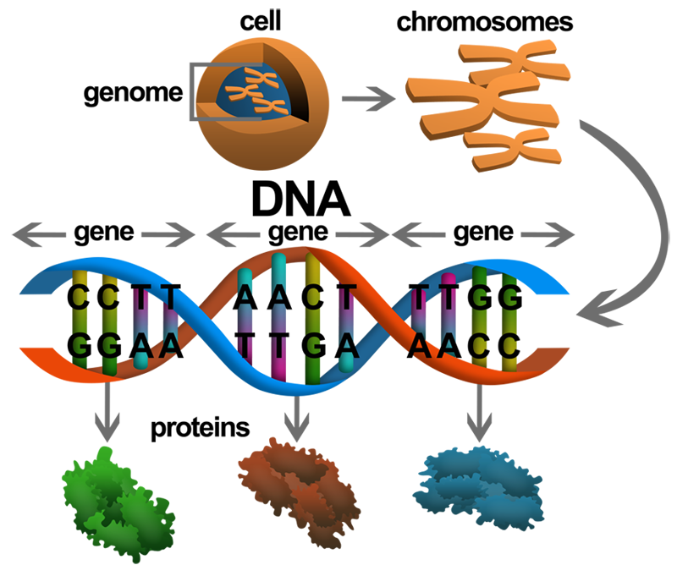
DNA to Genes

Slide 5
Our gene of interest: GAPDH
Glyceraldehyde-3-phosphate dehydrogenase
A housekeeping gene—a gene that is constitutively expressed and necessary for all cells to survive
Why is this important?
Catalyzes the 6th step of glycolysis (lab manual)
Also involved in membrane fusion, endocytosis, microtubule bundling and DNA repair among other functions.
Consists for 4 subunits—a tetramer, held together by noncovalent bonds
Can be a homodimer or heterodimer

Slide 6
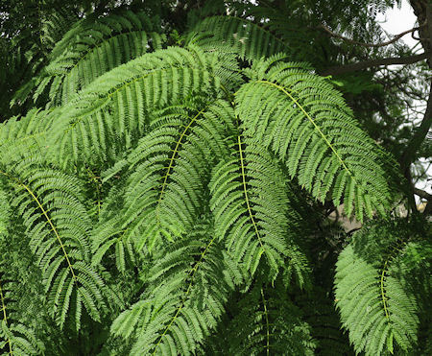
GAPDH cont.
8 Arabidopsis (pg. 5) GAPDH genes
GAPC—NAD+ dependent cytosolic form of GAPDH
All GAPDH isozymes found in eukaryotes are nuclear encoded and are believed to have originated in cyanobacteria (Martin el al., 2002).
These are bacteria capable of running photosynthetic metabolic rxns
We will amplify and sequence this gene from jacaranda leaves
The section of the gene to be amplified encodes around 2/3 of the protein, including the active site of the enzyme—Nested PCR
What is an isozyme?
Answer: enzymes that differ in amino acid sequence but catalyze the same chemical reaction

Slide 7
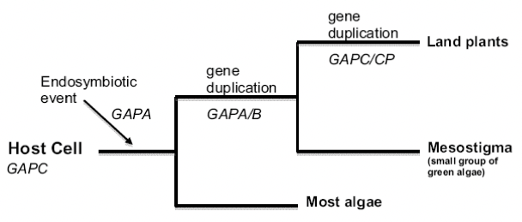
Evolution doesn’t change things that work!
Why did we choose to amplify the part of the genes that includes the active site?
Answer: it is a region of the gene where there is highest expected sequence homology to related genes. This is specially important for PCR.
Notes:
Talk about how this will come in handy with PCR

Slide 8
Overview of cloning the GAPC gene
Identify and extract
Identify and extract gDNA from jac plant
Amplify
Amplify region of GAPC gene using PCR
Assess
Assess the results of PCR
Purify
Purify the PCR product
Ligate
Ligate PCR product into plasmid vector
Transform
Transform bacteria with the plasmid
Isolate
Isolate plasmid from the bacteria
Sequence
Sequence DNA
Analyze
Perform bioinformatics analysis of the cloned gene

Slide 9
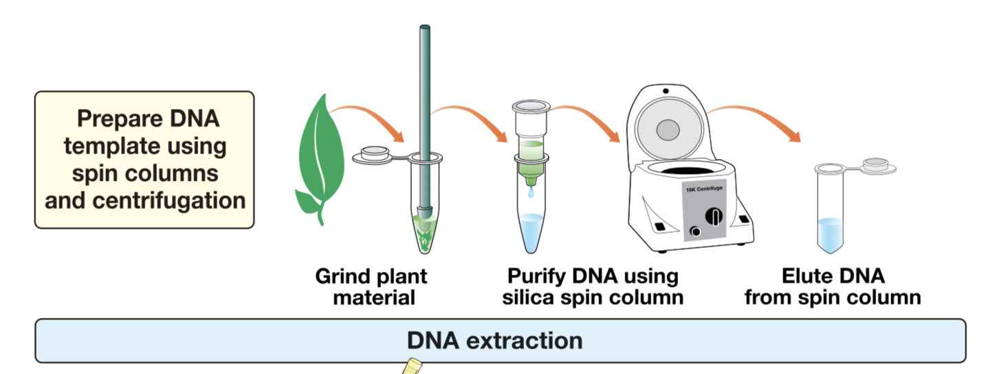
Extracting DNA
DNA is only one component that makes up cells
Membranes, organelles, nucleic acids, proteins & other chemical compounds.
DNA extraction is used to separate DNA from other cellular components
DNA must be both intact and free of contaminants after extraction
Most DNA is found is genomic DNA (gDNA) located in the nucleus
Today we will extract genomic DNA
Notes:
DNA can also be found in two other organelles–mitochondria and (in plant cells) chloroplasts. In bacteria also have small DNA elements called plasmids.

Slide 10
Purifying DNA from plants
Plants are multicellular eukaryotic organisms distinguished by rigid cells walls– this is a challenge DNA extraction
Cell walls are composed of multiple layers of cellulose among other polysaccharides which can colocalize with DNA during the purification process
Cells also have, nucleases (enzymes), that can digest DNA and acidic components found in plant vacuoles that can damage DNA
Notes:
If acidic components are found in plant vacuoles and DNA in the nucleus why would they damage DNA during extraction?

Slide 11
Grinding and Lysing Plant Tissue
When choosing the plant tissue, what do you want to look for?
Answer: young green leaves are best for gDNA extraction. Y? leaves are still growing and thus have a greater ratio of nuclear volume to cytoplasmic volume. Y? leaves also have fewer chemicals that can interfere with DNA isolation
To disrupt the cell wall, we must use (1) mechanical force:
We will be using micropestle for this lab.
(2) chemical methods like lysis buffer:
Prevents damage to DNA by the cell contents
EDTA—(1) removes Mg+ ions by chelation thus destabilizing the cell wall and cell membrane & (2) inhibits nucleases
Has buffering capacity (acidic components), most have pH 8.0
Nonionic detergent used to lyse plant cells and precipitate DNA
Plant cells are selectively permeable—they allow some molecules to pass through while blocking others. Cell membranes are composed of phospholipids (fat) and proteins. Detergents can be used to disrupt these.
It’s IMPORTANT to cut plant tissue into small pieces (1-2 mm), this will increase our DNA yield. Finer cuts go better into solution
Notes:
EDTA—ethylenediamine tetraacetate
CTAB–cetyltrimethylammonium bromide

Slide 12
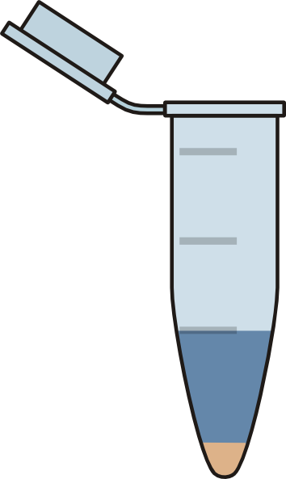
Purifying DNA
During DNA purification should you vortex?
Answer: NO! this can result in shearing of DNA. Intact, full-length DNA is necessary for subsequent steps in the experiment, such as PCR.
We centrifuge to remove cell debris
After cell lysis and centrifugation what remains in the supernatant?
DNA, RNA, & proteins
To remove these contaminants from DNA, we will use silica based purification, which relies on the binding of DNA to silica in the presence of high [salt], such as guanidine that disrupt hydrophobic interactions . Refer to pg. 14 on lab manual
Supernatant
Pellet

Slide 13
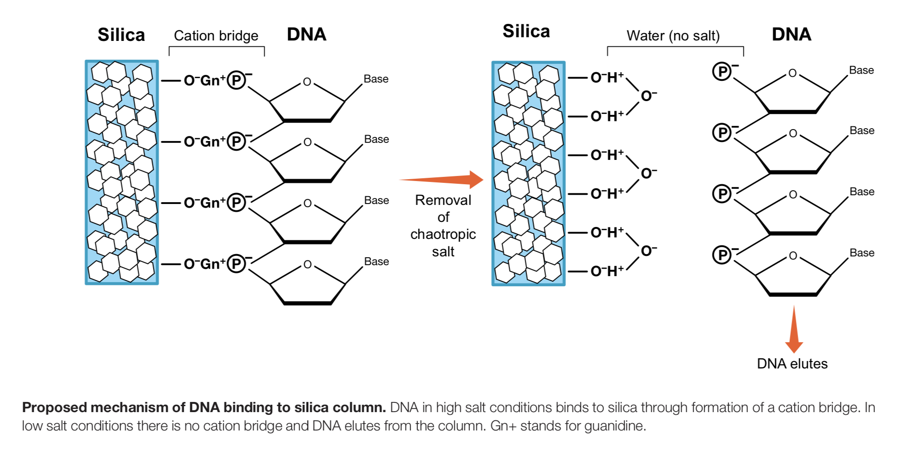
Ethanol helps DNA bind to the column!!!!
refer to pg. 14 on lab manual
Notes:
A chaotropic agent is a molecule in water solution that can disrupt the hydrogen bonding network between water molecules

Slide 14
Protocol
Collect young plant leaves from jacaranda tree
Weigh 75-100 mg & cut plant leaves into 1- 2 mm chunks
Grind in lysis buffer using a micropestle—Jamba juice quality
Remove solid plant material by centrifugation
Bind DNA to silica column in the presence of high salt and ethanol
Ethanol helps DNA bind to the column. What does the salt do?
While DNA binds to the silica column, protein, polysaccharides and lipids flow through after centrifugation
Wash column 3 X to remove contaminants
This removes any residual contaminants—protein, polysaccharides and lipids
Elute DNA using sterile H2O warmed to 70C
Warm H2O will solubilize the DNA

Slide 15
Considerations & common mistakes
Gloves and lab coats must be worn during this lab
Pay attention to parts of the protocol in italics—they explain the purpose of a given step
Step 5: before moving to the next step check that the tissue is Jamba Juice quality—please check with me at this step
Step 6: If necessary you may add an additional 50-100 ul. lysis buffer if your sample is not Jamba Juice quality—this will aid in lysis and to ensure a homogenous lysate
When you use the microcentrifuge-–make sure it is balanced—there should be two samples in each group
Step 9: total volume should be 900ul (400 of plant lysate & 500 ethanol)—volume check
Step 12: make sure all the supernatant has passed through the column before proceeding to the washes.
Step 15: Make sure you change the collection tube, This is your final product and you want to avoid re-contaminating it. Use the molecular grade water, not the water on your bench.
Step 17: Volume check!
Make sure to label your tubes with date, group #, and samples A or B

